Slide 1
CP Auto-reconfiguration SOP
Created by
Akira Huang ver. 1.2
Notes:
System Center Configuration Manager 是一套可以協助我們在內部部署和雲端中管理裝置和使用者的套件。
藉由使用Configuration Manager其站點系統來有效管理網路資源，進行用戶端與裝置的相關設定與管理，了解日常的管理工作，包括如何使用Configuration Manager管理應用程式、用戶端運作狀況、軟硬體清單、作業系統部署以及軟體更新。
那我們接下來就來看一下他是怎麼做的
---------------------------------------------------------
此外，您還將學習如何最佳化System Center端點保護、管理合規性、以及建立管理查詢和報表，為經驗豐富的企業桌面管理人員奠基正確且簡化部署、管理、與維護中、大型企業組織內，加入或未加入網域的電腦與自帶裝置(BYOD)的管理技能。

Slide 2


Work Flow
Connection between RM & SoC via cmd
Connection between
SoC & FTP
via utility
Upload 3 files to SoC via FTP
Launch CP_Auto-reconfig.sh
Create SoC user
Account & Password
Start serial session –i <x> -b 1
Tip. <x> : slot number
<1> systemctl start persistent-user
<2> adduser -G sudo ovl
<3> overlake
<4> overlake
Tip. Step 3 & 4 is password
CP_Auto-reconfig.sh
fpga.py
CP_Auto-reconfig.sh
SoCFPGATestSvc.service

Slide 3
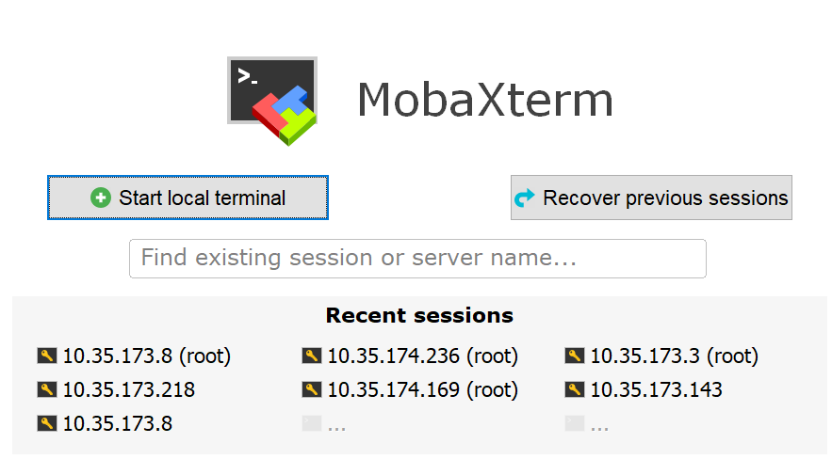
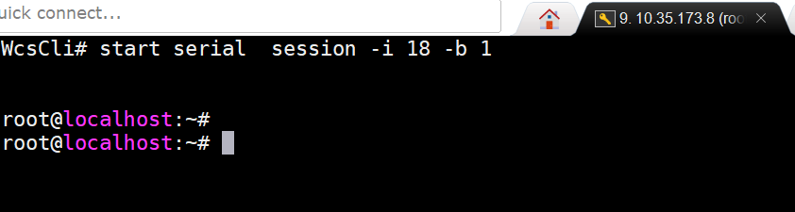
RM & SoC connection by CMD
Execute utility to connect to RM server by SSH.
Connect from RM to SoC by command, then terminal will stay on root@localhost:~# # start serial session -i <x> -b 1 [<x>: x is the slot number of blade on RM]
In this case, RM is 10.35.173.8
In this case, blade is on 18th slot

Slide 4
Create SoC user account & password
Typing below command to create user account and password
systemctl start persistent-user [ create user account ]
adduser -G sudo ovl [ add new user : ovl ]
overlake [ create password ]
overlake [ confirm password ]

Slide 5
SoC & FTP connection by utility (1/2)
Verify the Soc’s IP address by command
# ifconfig
In this case: IP is 10.35.173.111

Slide 6
SoC & FTP connection by utility (2/2)
Execute FilleZilla utility and going to “Site Manager”, then setup FTP
1
In this case:
<1>: open “site manager” window
<2>,<3>: create new sit and name it
<4>: Protocol: SFTP-SSH file xxxxx Host: SoC’s IP Logon Type: Normal User: SoC’s user account Password: SoC’s user’s password
e.g. Protocol: SFTP-SSH file Transfer Protocol Host: 10.35.173.111 Logon Type: Normal User: ovl Password: overlake
4
3
2

Slide 7
Upload script to SoC via FTP
Select below script files on local side then upload them to SoC on /home/ovl
Files:
CP_autoReconfig.sh
SoCFPGATestSvc.service [main]
fpga.py [main]

Slide 8
Launch CP_autoReconfig.sh
Change direction to /home/ovl because the script is located at there. Then, adjust right as rwx (777) and launch script.
# cd /home/ovl
# sh CP_autoReconfig.sh
SoC will auto reboot once after launching this script, then we won’t reconfigure CP from Golden to APP while SUT execute AC or DC, SoC will auto reconfigure as App image.

Slide 9
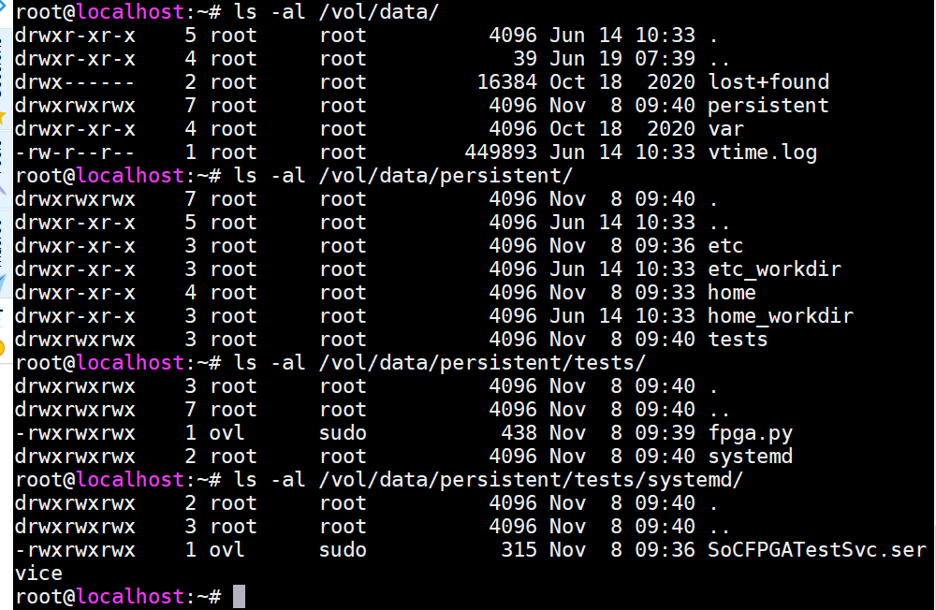
Trouble shooting
Tip.
<1> adjust right: chmod 777 ..path/<file>
<2> check folder property and right level:
# ls -al ..path/
Check the folders were created correctly.
persisten : under /vol/data and right is rwx
tests: under /vol/data/persisten and right is rwx
systemd: under /vol/data/persisten/tests and right is rwx
Check the main scripts were at right location:
SoCFPGATestSvc.service: - under /vol/data/persisten/tests/systemd - Right is rwx
fpga.py - under /vol/data/persisten/tests - Right is rwx

Slide 10
Attachment
CP_Auto-reconfig.sh
fpga.py
SoCFPGATestSvc.service

